Slide 1
NFC Enabled COVID Testing Kit.
Ayush Bajpai
ayush10055@gmail.com

Slide 2
Coronavirus
Coronavirus disease (COVID-19) is an infectious disease caused by a newly discovered coronavirus.
Most people infected with the COVID-19 virus will experience mild to moderate respiratory illness and recover without requiring special treatment. Older people, and those with underlying medical problems like cardiovascular disease, diabetes, chronic respiratory disease, and cancer are more likely to develop serious illness.

Slide 3


Testing
For our project we will be using antibody IgM/IgG testing kits.
The present IgM/IgG serological assay is designed to complement RT-qPCR in the diagnosis of SARS-CoV-2 infections.
Cheap
This kit is way cheaper than any other kit available.

Slide 4
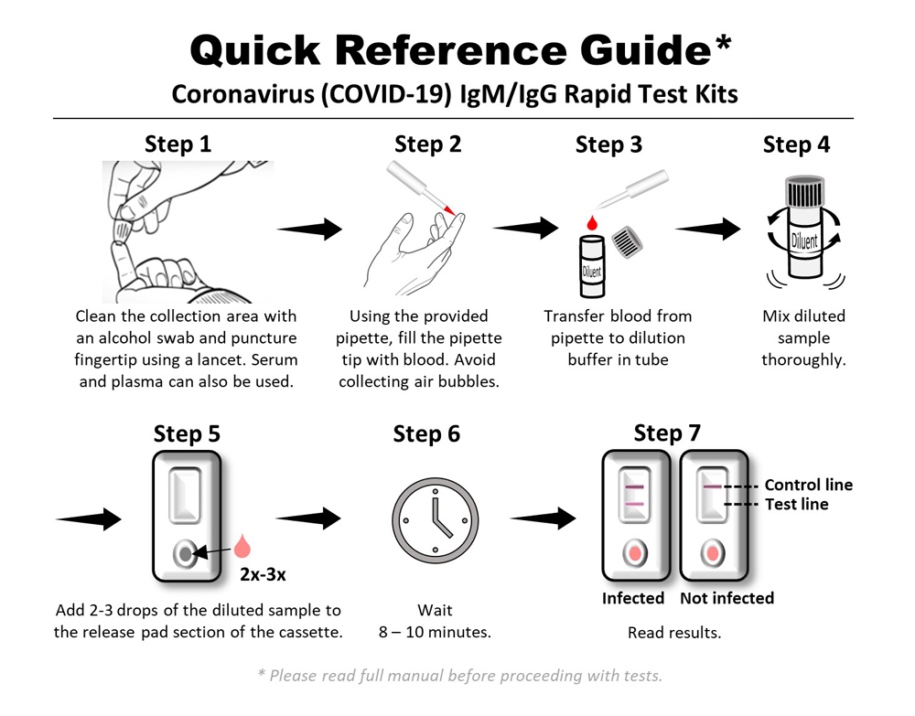
Testing Procedure:

Slide 5
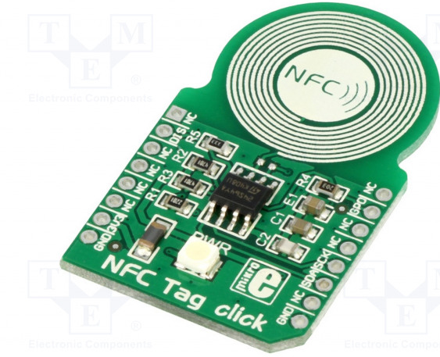
What is NFC?
NFC stands for “Near Field Communication” and, as the name implies,
it enables short-range communication between compatible devices.
This requires at least one transmitting device, and another to receive
the signal. A range of devices can use the NFC standard and will be
considered either passive or active.

Slide 6
WHAT IF?
We can get direct information from testing kit directly on our server?
*
This will save a lot of time,if people will be able to test themselves,and their result will get delivered directly to us.

Slide 7
We will be able to get the test results on our screen via servers online,so there would be no contact for even testing,people also won’t be needing to come out from homes and hence it is a better way to test people.
*
We just need to distribute kits in homes..

Slide 8
IDEA
So my idea is to connect a NFC to the testing kit which will be configured so as to send the testing result directly to the server or any nearby hospital.

Slide 9
There will be a color detecting sensor at the end of testing kit,which will detect the color of the test (red=positive),and after the test,the color result will be sent to NFC.

Slide 10
This NFC will connect to mobile phone and then send the message or the result to the nearest hospital,we can also connect the nfc to send the result directly to the aarogya app.

Slide 11
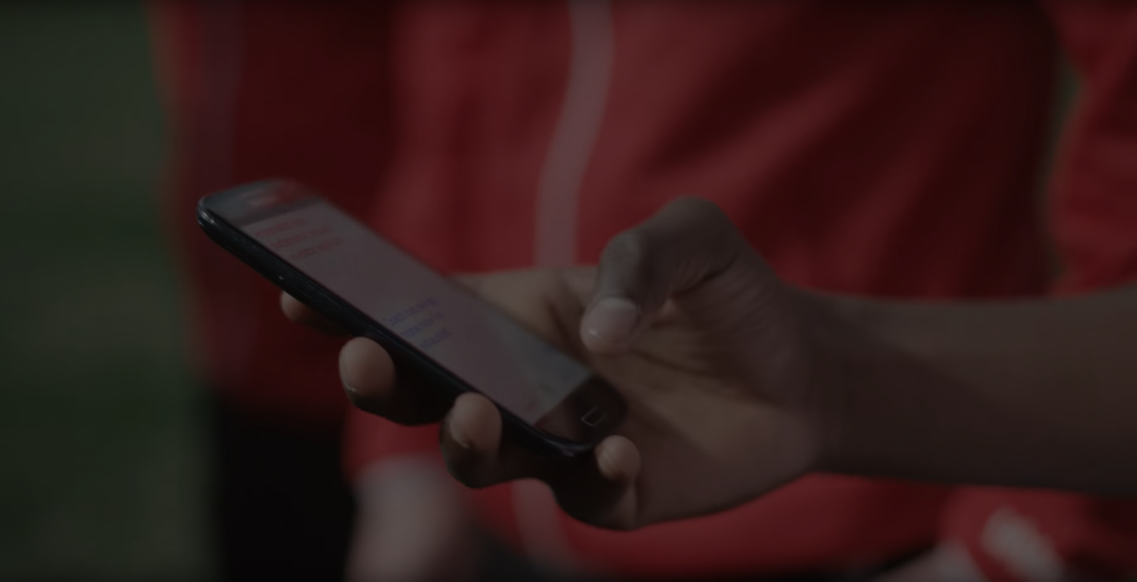
About 93 percent of cellphones today are NFC equipped.

Slide 12
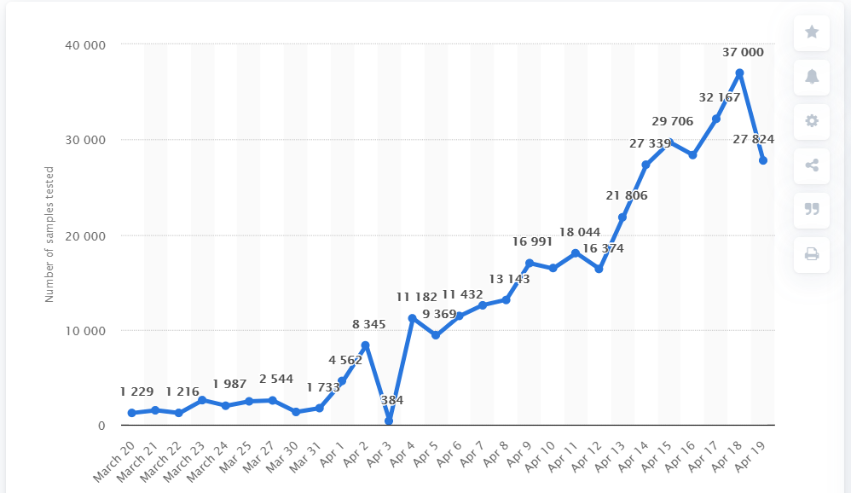
Daily number are sample tested for COVID-19 in India.

Slide 13
Benefits of using NFC
Easy to use,almost every phones are equipeed with NFC.
One of the Cheapest way to test for Covid.
People can do their own test,hence less physical contact.

Slide 14

By-
AYUSH BAJPAI
ayush10055@gmail.com

